Slide 1
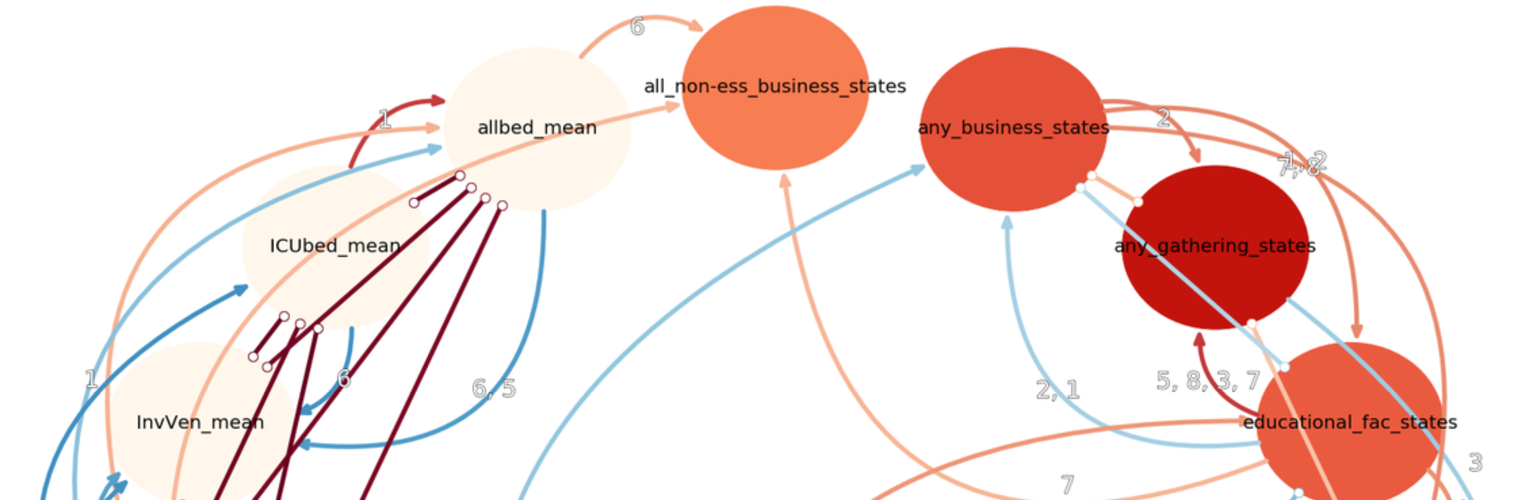
Smart Data Analytics
Assignment 4 – Causal Inference
Zihan Chen, Thassilo Helmold, Gerrit Merz, Robin Schnaidt ‒ Team 4

Slide 2
Content
Causal Inference Introduction
General Understanding
Method Overview
Experiment Preparation
Causeme
SDIL Batch System
Causal Discovery Benchmark
PCMCI
Transfer Entropy
TCDF
Application of Causal Discovery on COVID-19 data
Summary & Conclusions

Slide 3
Motivation
Obtain knowledge through experiments
But: What to do if experiments are not feasible?
https://home.cern/sites/home.web.cern.ch/files/2018-10/lhc-tunnel-2302977.jpg
Notes:
Wissen kann nur durch exp. Falsifiziert und ggf. Bestaetigt werden
Wisschaftstheorie kann nur aus Experimenten kommen
z.B grosse technische Anlagen (LHC)
aber auch andere Experimente: soziale Experimente
ABER: ethishen Gruenden nicht moeglich, dauern zu lang, nicht realistisch umzetzbar (oder zu teuer)
Statistische Methoden mit der Idee: Aus Datensaetzen die schon bestehen, kausale Zusammenhaenge

Slide 4
Causal Inference
“Correlation does not imply causation”
Weather Example: High correlation between rain and number of clouds
…but which phenomenon causes which one?
Correlation is symmetric measure: no sense of direction
Causality: "A signal X is said to cause Y if the future realizations of Y can be better explained using the past information from X and Y rather than Y alone" (Granger 1969)
Need for asymmetric measures
⟹
?
⟹
Notes:
Need for asymmetric measures: Allow quantification of directions
Drawing conclusions on cause-effect relationships from observed data
Identify chain of causes

Slide 5
Transfer Entropy
R Package "RTransferEntropy"
Shannon entropy
Rényi entropy
PCMCI (Runge 2019)
Python Package "Tigramite"
Iterative conditional independence testing
Can be used with different Independence tests
Temporal Causal Discovery Method (TCDF)
Uses Attention-based Convolutional Network
Notes:
Measuring the amount of directed (time-asymmetric) transfer of information between two random processes
Discovers causal relationships between time series
addresses time-lagged causal discovery
applicable to discrete or continuously-valued time series

Slide 6
Causeme
Evaluation with the Causeme-Benchmark-Platform
No Ground-Truth -> Stick to given metrics
Single benchmark can contain up to 200 datasets
One benchmark group contains many benchmarks of different complexity
=> Need to conduct many experiments

Slide 7

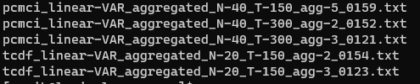
SDIL-Batch-System
Use SDIL-Batch-System to efficiently execute many experiments in parallel
Use modified sample script (command line parameters)
Progress reporting via temporary file names
Single experiments still take a long time, up to 12 hours and more

Slide 8
Evaluation
Which benchmark datasets to use?
Which properties does our COVID-dataset have?
Algorithm should work well for all datasets (robustness)
Evaluation of metrics on small datasets from very different benchmark groups:
Linear-VAR
Linear-VAR-aggregated
TestWEATH
TestCLIM
river-runoff

Slide 9
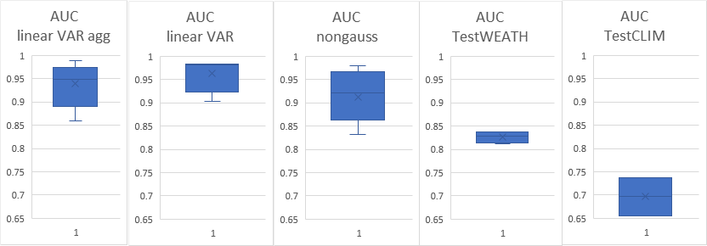
PCMCI
Generally good performance
Very sensitive to length of data
Linear-VAR | AUC | F | FPR | TPR
T-150 | 0.9038 | 0.8295 | 0.0533 | 0.5983
T-300 | 0.9824 | 0.9379 | 0.055 | 0.9167
nongauss-VAR | AUC | F | FPR | TPR
T-150 | 0.8326 | 0.7986 | 0.0627 | 0.508
T-200 | 0.8968 | 0.9211 | 0.0618 | 0.6672
T-300 | 0.9622 | 0.9406 | 0.0582 | 0.855
+ | -
Fast runtime on small/medium datasets Good Performance on many benchmarks Few hyperparameters | Slow with nonlinear CI-Tests Slow for large numbers of variables

Slide 10
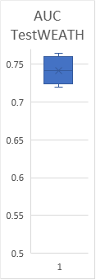
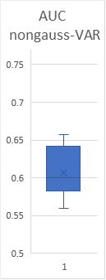
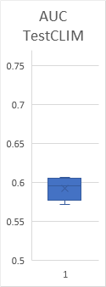
Transfer Entropy
R Package "RTransferEntropy"
Runtime on local machine for calculating pairwise transfer entropy (calc_te) for one benchmark ~ 5min
+ | -
Very fast runtime when calculating only transfer entropy | No p-values function Overall worse performance than PCMCI

Slide 11
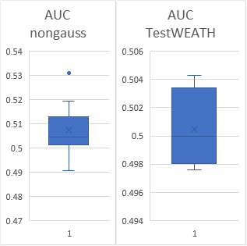
Temporal Causal Discovery Framework (TCDF)
Generally bad / medium performance
Sometimes longer series led to worse performance
Linear-VAR | AUC | F | FPR | TPR
T-150 | 0.5333 | 0.4918 | 0.2717 | 0.3383
T-300 | 0.4858 | 0.4015 | 0.2783 | 0.25
+ | -
Medium runtime on small/medium datasets Gives back a set of Causal Links Can tune many hyperparameters | Generally slow Generally bad performance Extremely slow with “better” settings Must tune many hyperparameters

Slide 12
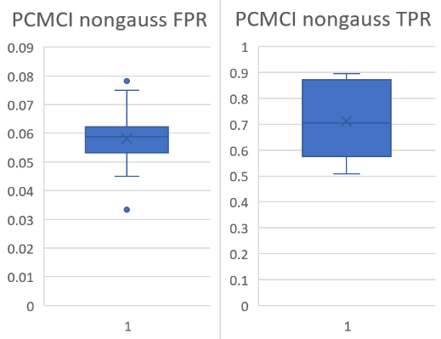
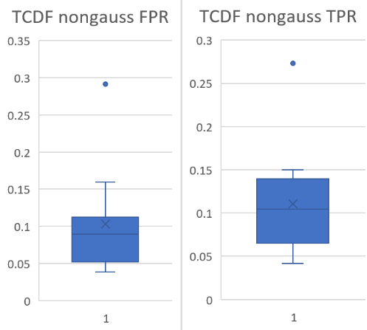
Benchmark-Groups
nongauss-VAR: Linear vector-autoregressive time series model with gaussian and non-gaussian noise
12 Benchmarks, maximum N=20

Slide 13
Benchmark-Groups
TESTWEATH: Nonlinear datasets of weather data
4 benchmarks, maximum N=10
nonlinear -> PCMCI-ParCorr not really suitable (but GPDC, CMIknn too slow)
Experiment | Method | Runtime (s) | AUC | F-measure | FPR | TPR
TestWEATH_N-10_T-1000 | test_pcmci | 10,2872 | 0.8201 | 0.5388 | 0.0846 | 0.6047
TestWEATH_N-10_T-1000 | test_tcdf | 90,9068 | 0.5006 | 0.067 | 0.0203 | 0.0216
TestWEATH_N-10_T-2000 | test_pcmci | 12,8951 | 0.8371 | 0.5476 | 0.0886 | 0.6564
TestWEATH_N-10_T-2000 | test_tcdf | 62,6077 | 0.5043 | 0.0815 | 0.0166 | 0.0252
TestWEATH_N-5_T-1000 | test_pcmci | 3,2136 | 0.8126 | 0.6698 | 0.1052 | 0.6203
TestWEATH_N-5_T-1000 | test_tcdf | 26,7976 | 0.4976 | 0.1019 | 0.0355 | 0.0308
TestWEATH_N-5_T-2000 | test_pcmci | 3,2019 | 0.837 | 0.6684 | 0.129 | 0.6971
TestWEATH_N-5_T-2000 | test_tcdf | 12,9293 | 0.4994 | 0.1191 | 0.0388 | 0.0376

Slide 14
TCDF Hyperparameters
TCDF delivers medium/bad results on all our benchmarks
Maybe the default hyperparameters are just bad for these?
Kernel size has to fit to the maximum time-lag in the dataset.
Search over different configurations of key hyperparams:
setting_nr | layers | epochs | lr | significane
0 | 0 | 1000 | 0.01 | 0.8
1 | 1 | 1000 | 0.01 | 0.8
2 | 0 | 5000 | 0.01 | 0.8
3 | 0 | 5000 | 0.001 | 0.8
4 | 0 | 1000 | 0.01 | 0.9

Slide 15
TCDF Hyperparameters
Setting | Time | AUC | F-Score | FPR | TPR
setting_0 | 8,7968 | 0.5333 | 0.4918 | 0.2717 | 0.3383
setting_1 | 15,1052 | 0.5375 | 0.5076 | 0.3033 | 0.3783
setting_2 | 43,5577 | 0.5308 | 0.4935 | 0.2917 | 0.3533
setting_3 | 41,7921 | 0.5317 | 0.4816 | 0.25 | 0.3133
setting_4 | 8,1738 | 0.5358 | 0.5018 | 0.2917 | 0.3633
linear-VAR_N-3_T-150
Setting | Time | AUC | F-Score | FPR | TPR
setting_0 | 6,3644 | 0.5192 | 0.4721 | 0.2883 | 0.3267
setting_1 | 10,2512 | 0.5017 | 0.4698 | 0.37 | 0.3733
setting_2 | 31,8925 | 0.5217 | 0.473 | 0.2783 | 0.3217
setting_3 | 31,1702 | 0.5017 | 0.4457 | 0.3033 | 0.3067
setting_4 | 6,4375 | 0.5175 | 0.4913 | 0.36 | 0.395
No clear results, optimal hyperparams depend on the concrete dataset
But: An additional hidden layer often leads to more detected causal links
linear-VAR_aggregated_N-3_T-300_agg-3
Setting | Time | AUC | F-Score | FPR | TPR
setting_0 | 91,102 | 0.5455 | 0.3333 | 0.0 | 0.0909
setting_1 | 212,4243 | 0.6322 | 0.5556 | 0.0083 | 0.2727
setting_2 | 595,2961 | 0.6736 | 0.5714 | 0.0165 | 0.3636
setting_3 | 500,9142 | 0.5909 | 0.5263 | 0.0 | 0.1818
setting_4 | 92,5449 | 0.6322 | 0.5556 | 0.0083 | 0.2727
River-Runoff

Slide 16
Causal Discovery for COVID-19 Data Sets
Let’s try to apply what we have learned to data sets about COVID-19, to understand the dynamics of the pandemic
Obvious: Only few experiments possible, urgent - perfect use case
Here: Germany, Italy, US
IHME data sets
Time series such as daily: Confirmed infections, hospitalization, ventilation capacity, mobility score, …
Combine with regional summary data provided by IHME

Slide 17
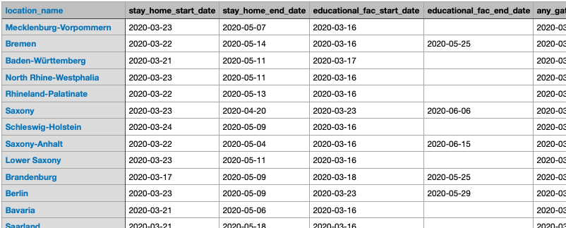
Regional Data for Germany - Augmentation
Construct new time series that are indicators for interesting potential influences on the pandemic
Federal state level ‘counters’: Increase when state applied measure, decrease when it is relaxed
Filter manually from all global IHME regions (result preview below)

Slide 18
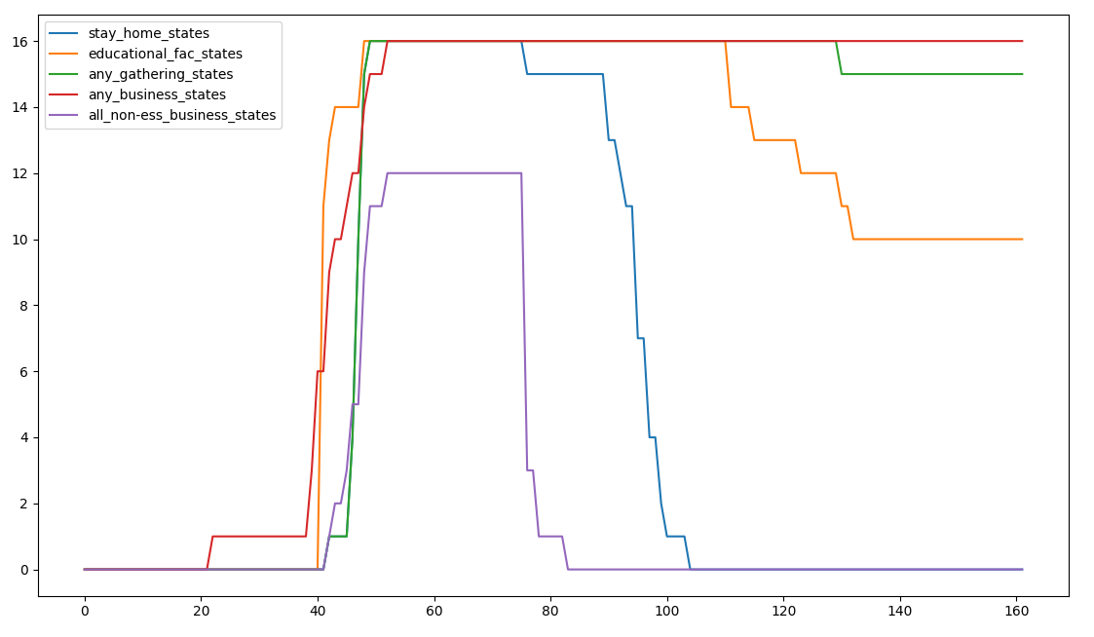
Regional Data for Germany: Time Series Added

Slide 19
Regional Data for Germany: Time Series Added
“Lockdown”
begins gradually

Slide 20
Regional Data for Germany: Time Series Added
Relaxation
of measures

Slide 21
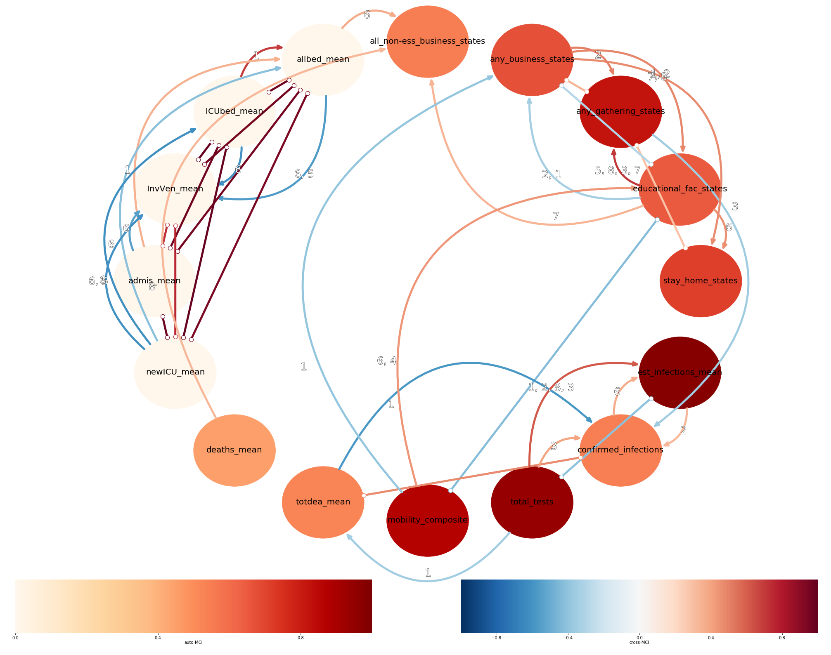
PCMCI for COVID-19: Germany (Tau=8)

Slide 22
PCMCI for COVID-19: Germany (Tau=8)

Slide 23
PCMCI for COVID-19: Germany (Tau=8)

Slide 24
PCMCI for COVID-19: Germany (Tau=8)

Slide 25
PCMCI for COVID-19: Germany (Tau=8)

Slide 26
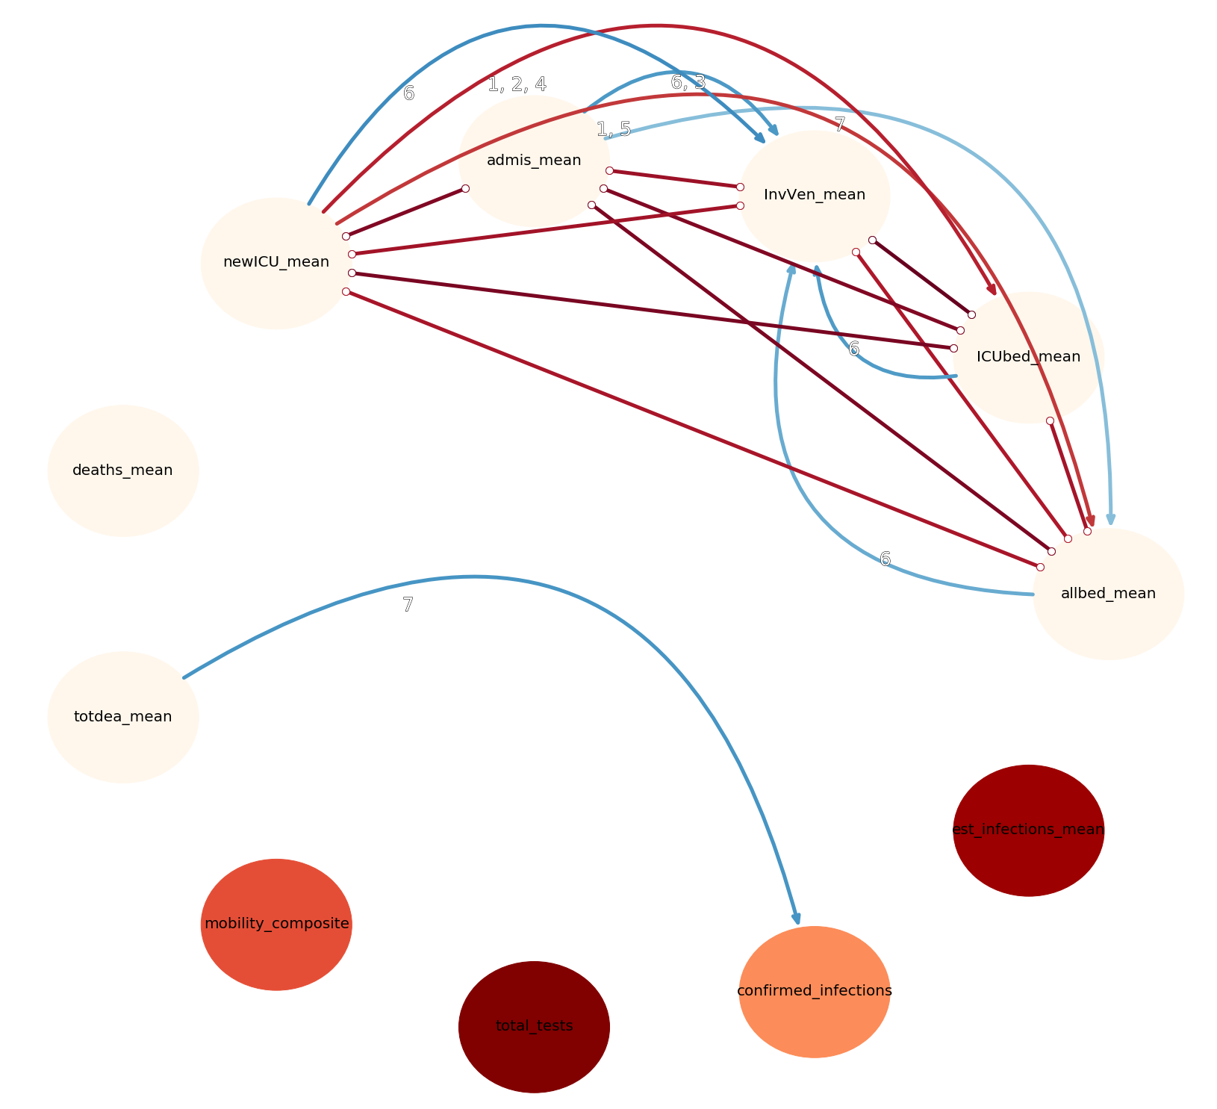
PCMCI for COVID-19: Italy (Tau=8)

Slide 27
PCMCI for COVID-19: Italy (Tau=8)

Slide 28
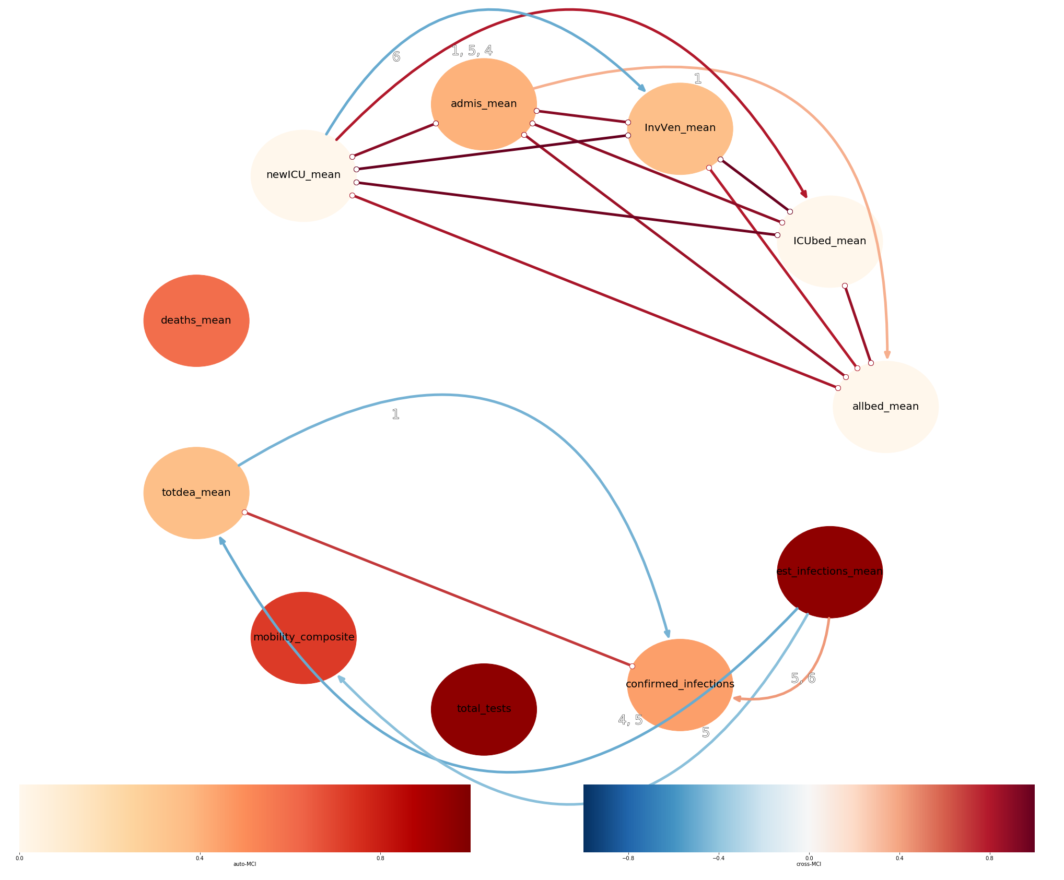
PCMCI for COVID-19: US (Tau=8)

Slide 29
PCMCI for COVID-19: US (Tau=8)

Slide 30
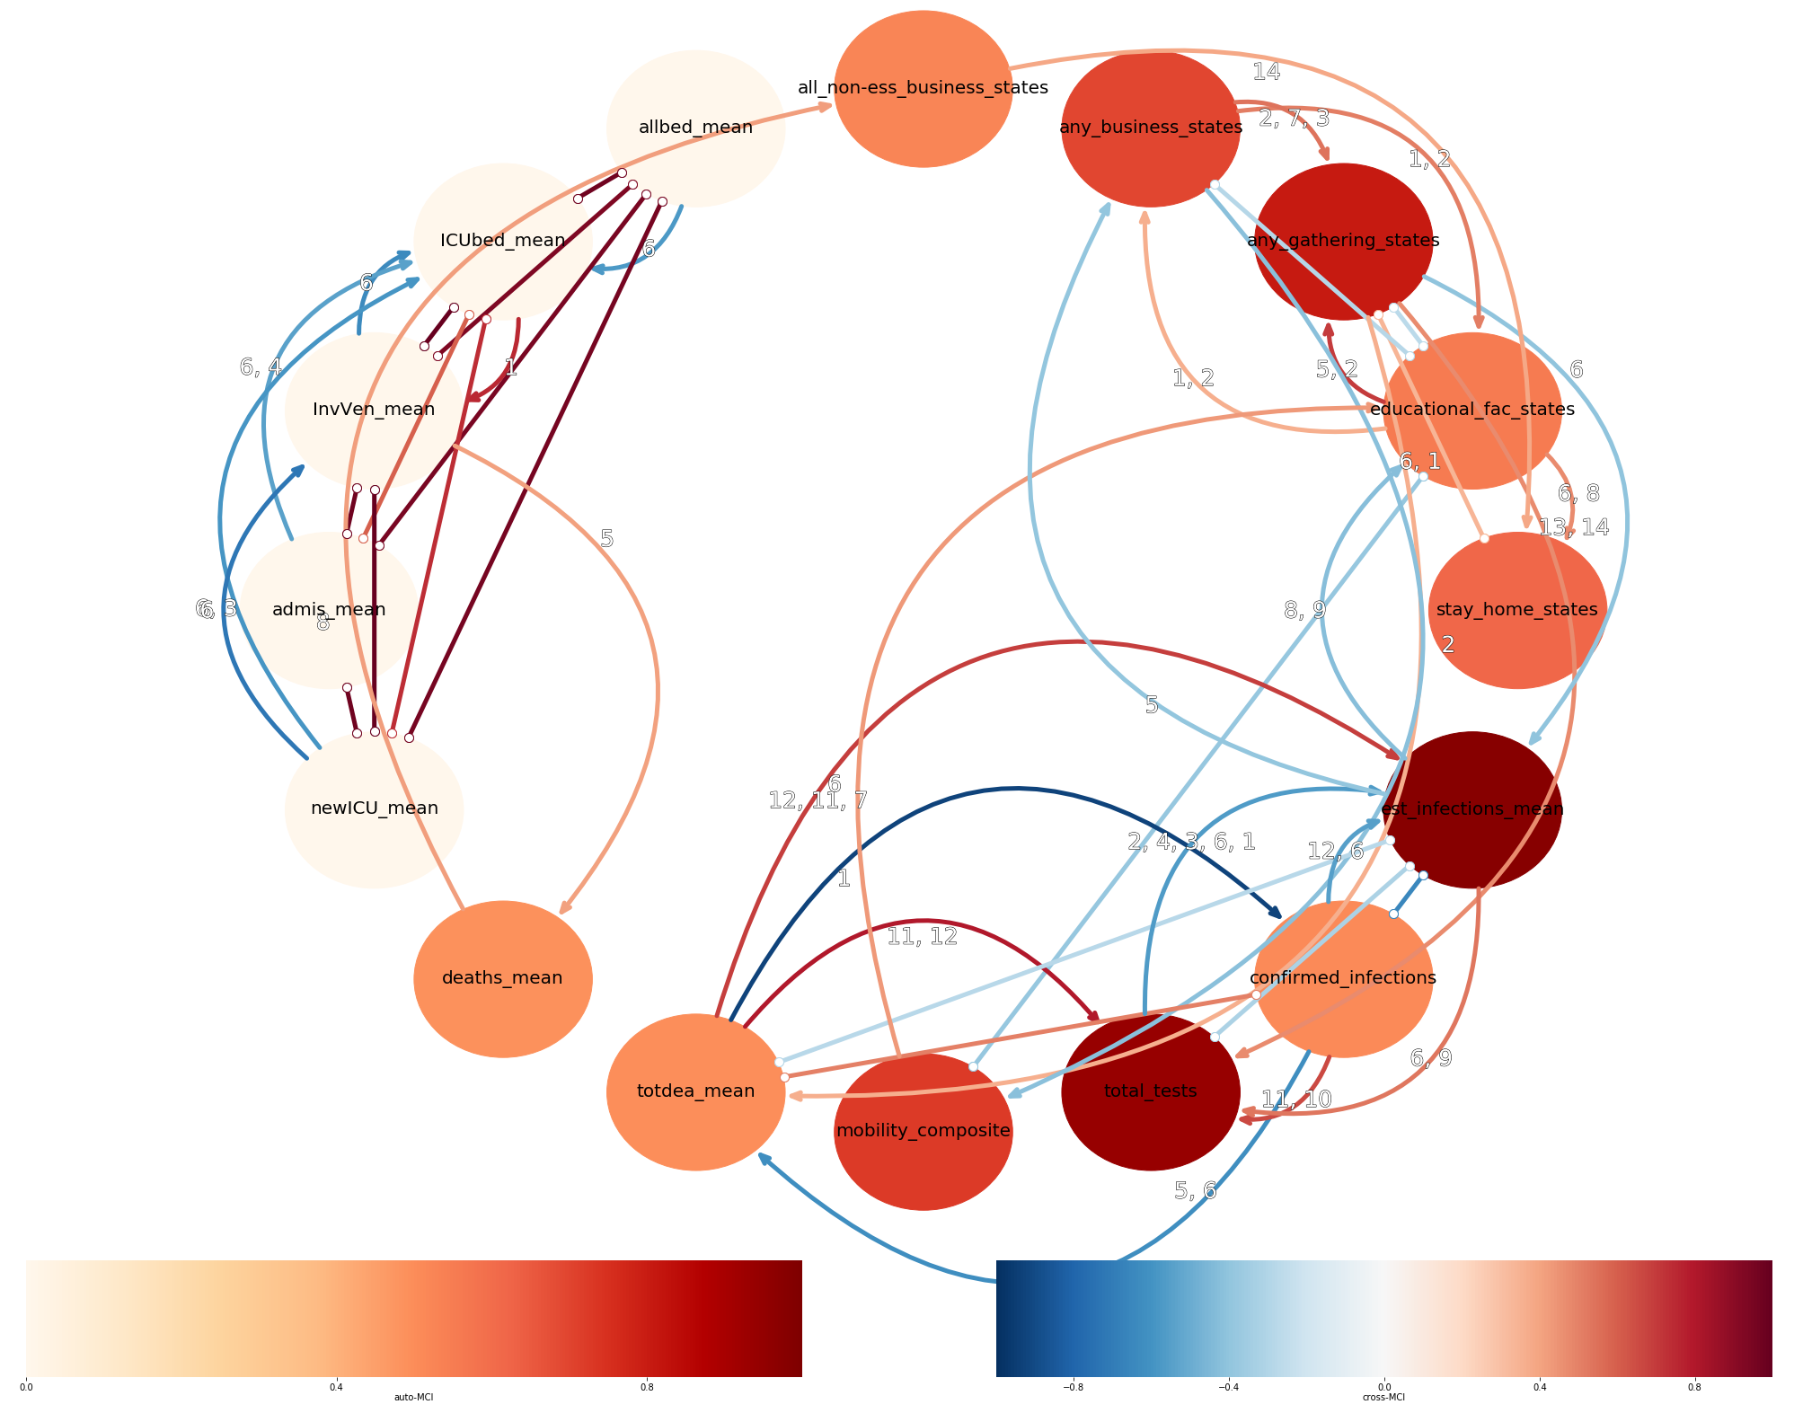
PCMCI for COVID-19: Germany (Tau=14)

Slide 31
PCMCI for COVID-19: Germany (Tau=14)

Slide 32
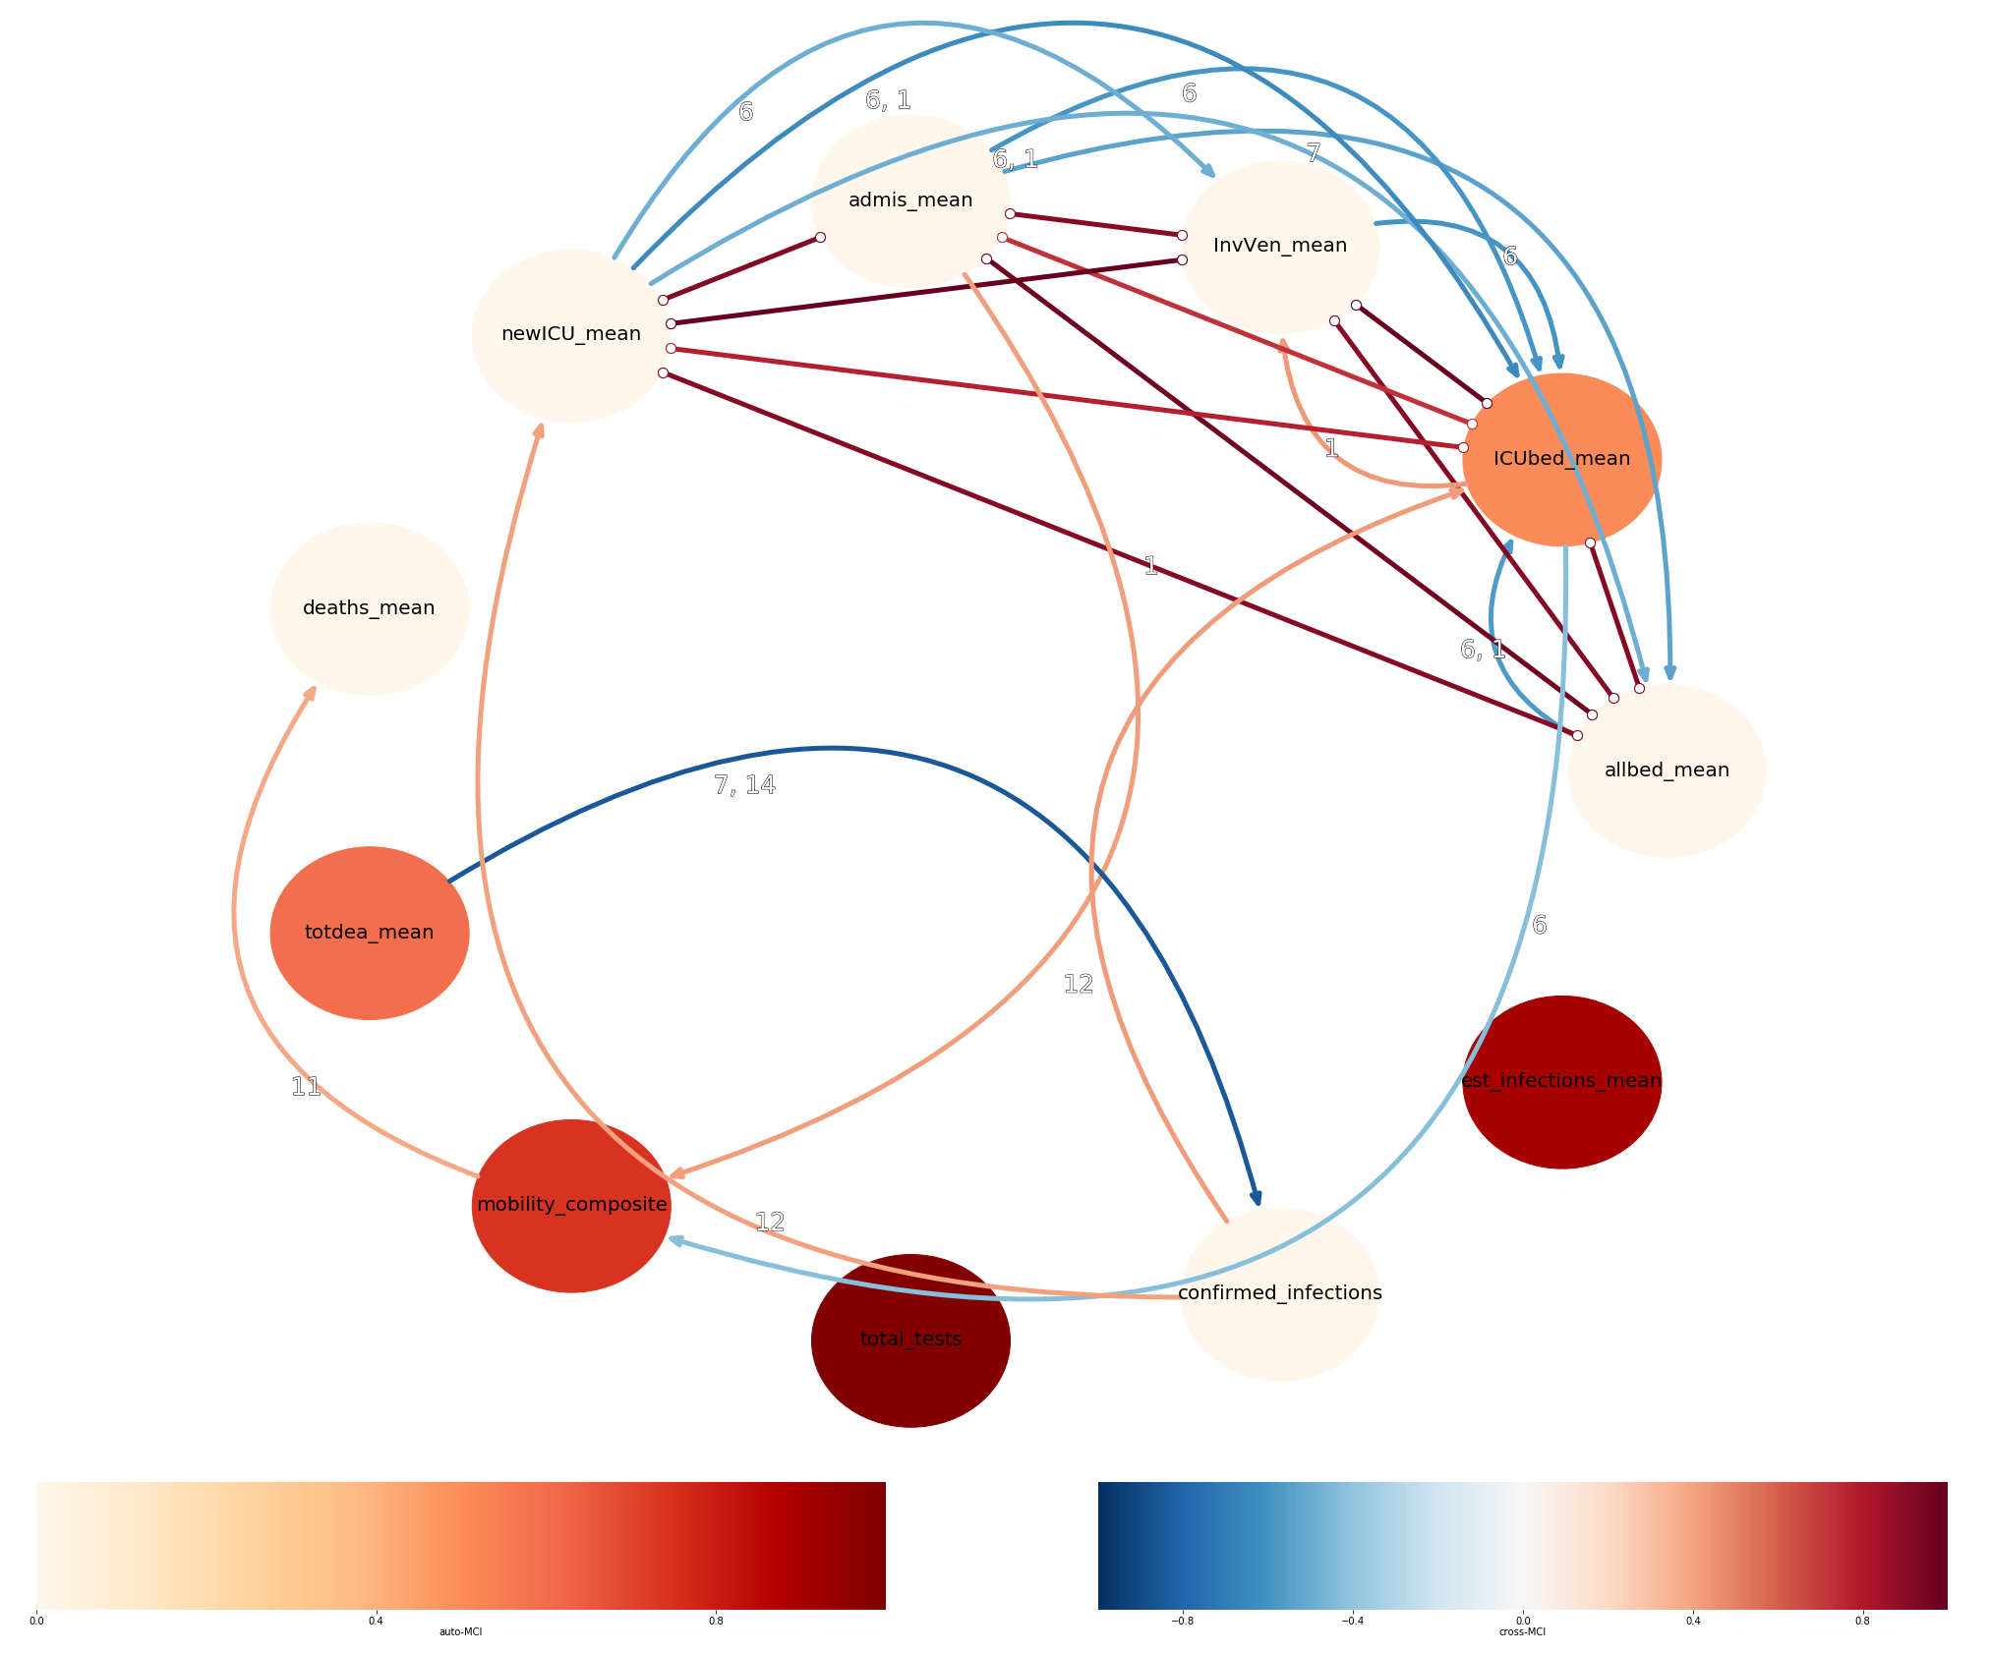
PCMCI for COVID-19: Italy (Tau=14)

Slide 33
PCMCI for COVID-19: Italy (Tau=14)

Slide 34
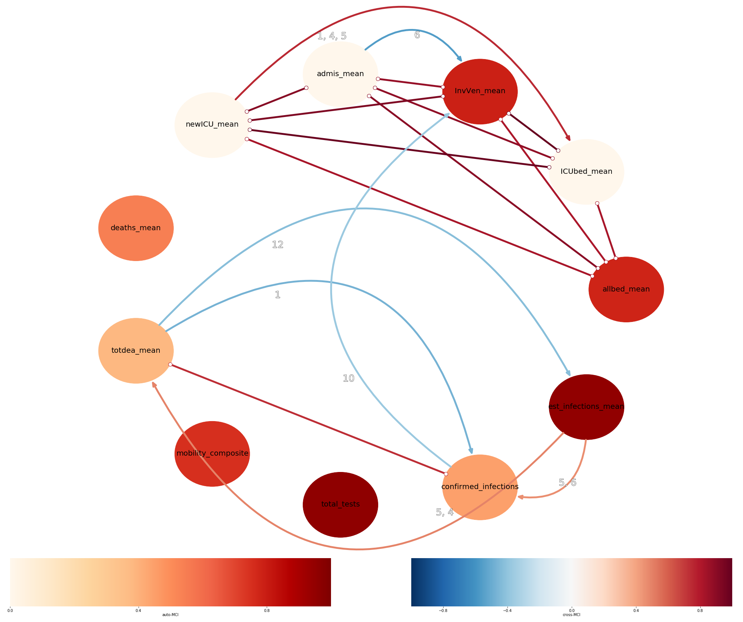
PCMCI for COVID-19: US (Tau=14)

Slide 35
PCMCI for COVID-19: US (Tau=14)

Slide 36
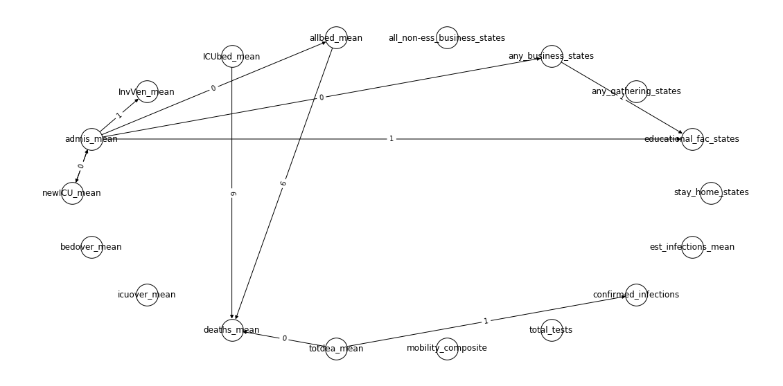
TCDF for COVID-19: Germany

Slide 37
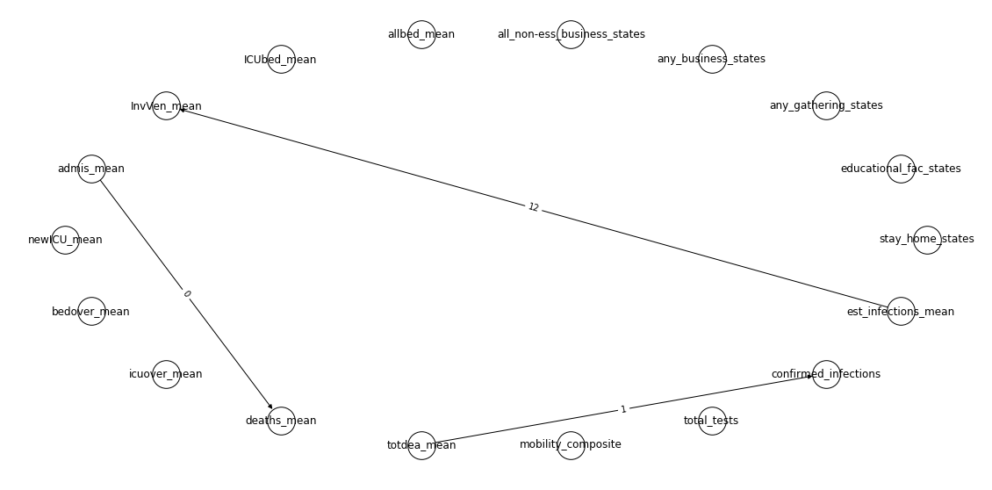
TCDF for COVID-19: Germany (kernels=14)

Slide 38
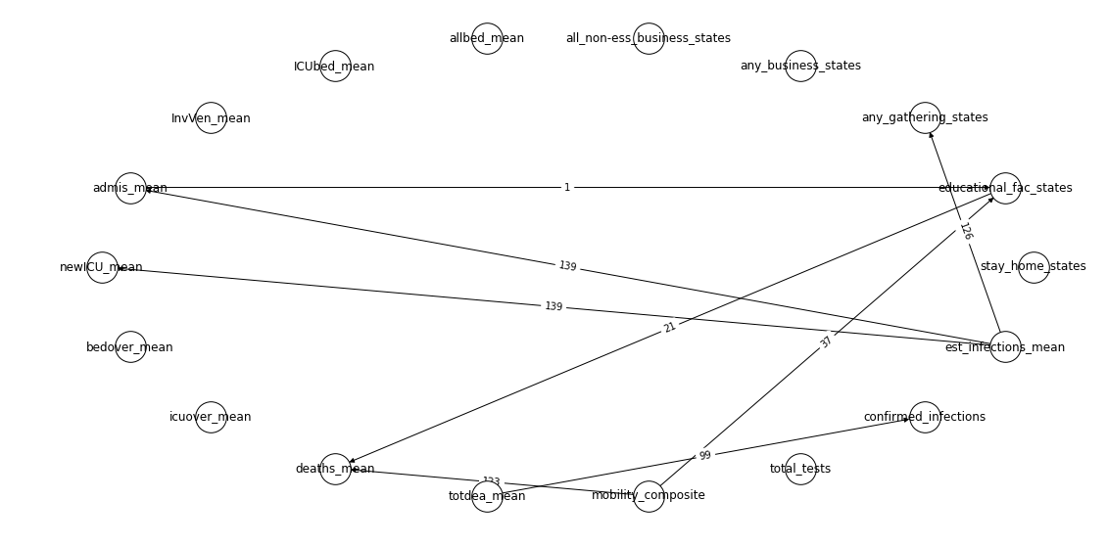
TCDF for COVID-19: Germany (kernels=14, one hidden layer)

Slide 39
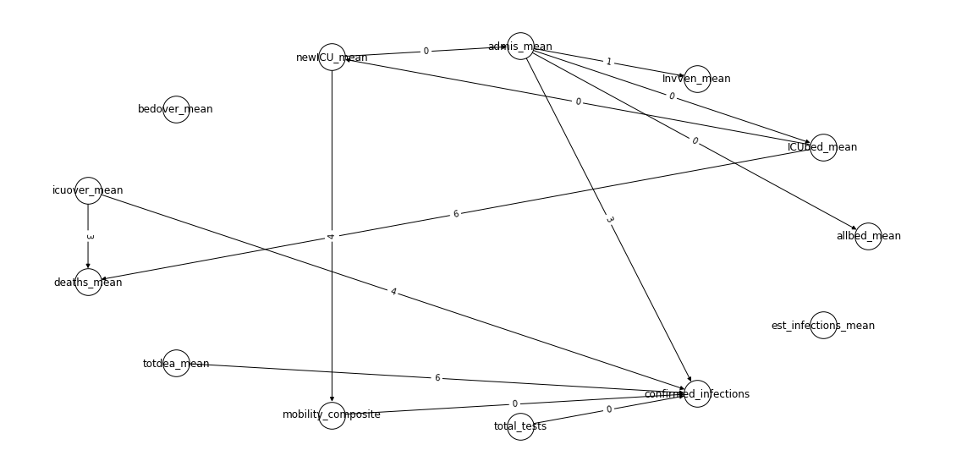
TCDF for COVID-19: Italy (lr=0.01)

Slide 40
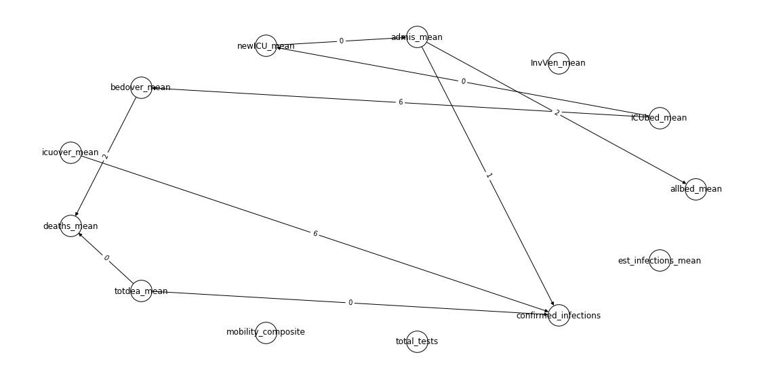
TCDF for COVID-19: US (lr=0.01)

Slide 41
Summary & Conclusions
Many interesting application scenarios supporting scientific research for causal inference and discovery
Today, many limitations
Validation of unsupervised methods can be challenging – careful approach and domain knowledge often needed
Causal Inference a future “hot topic” for ML research

Slide 42
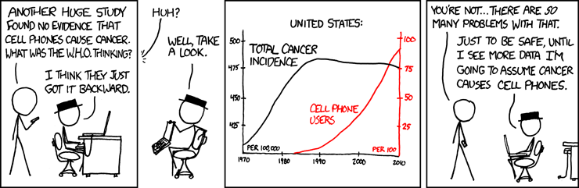
Thank you for your attention!
https://xkcd.com/925/

Slide 43
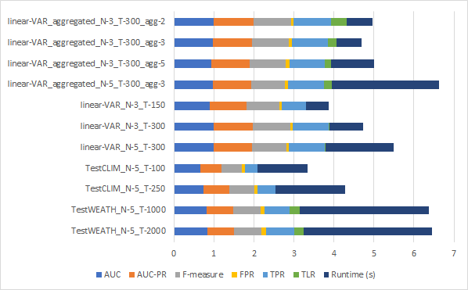
PCMCI Exploration (Backup)
Very good performance on basic linear datasets
Runtime can increase heavily when increasing variables or time steps
Worse performance on other datasets
Runtime very high for certain experiments

